Slide 1
Powerpoint 10: French Art in the 17th Century

Slide 2
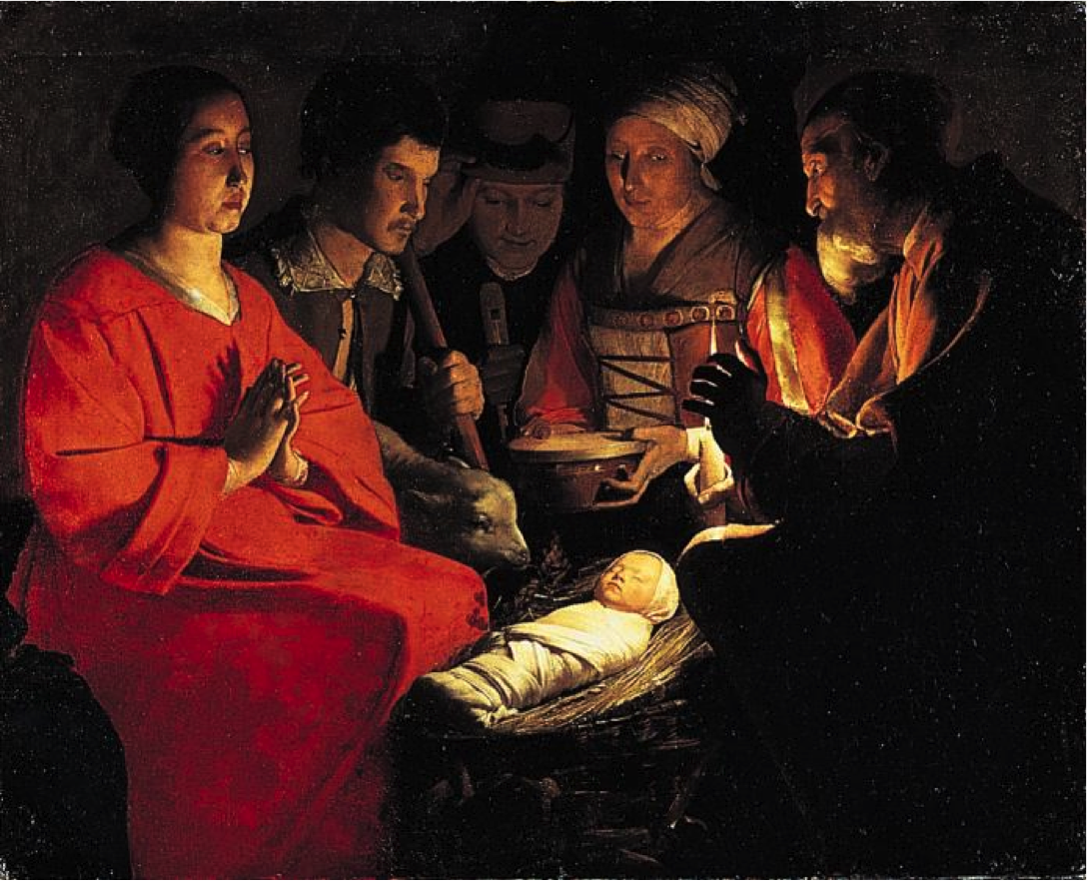
@ (25-36) Georges De La Tour, Adoration of the Shepherds, c. 1645-50, oil on canvas, Louvre, Paris

Slide 3
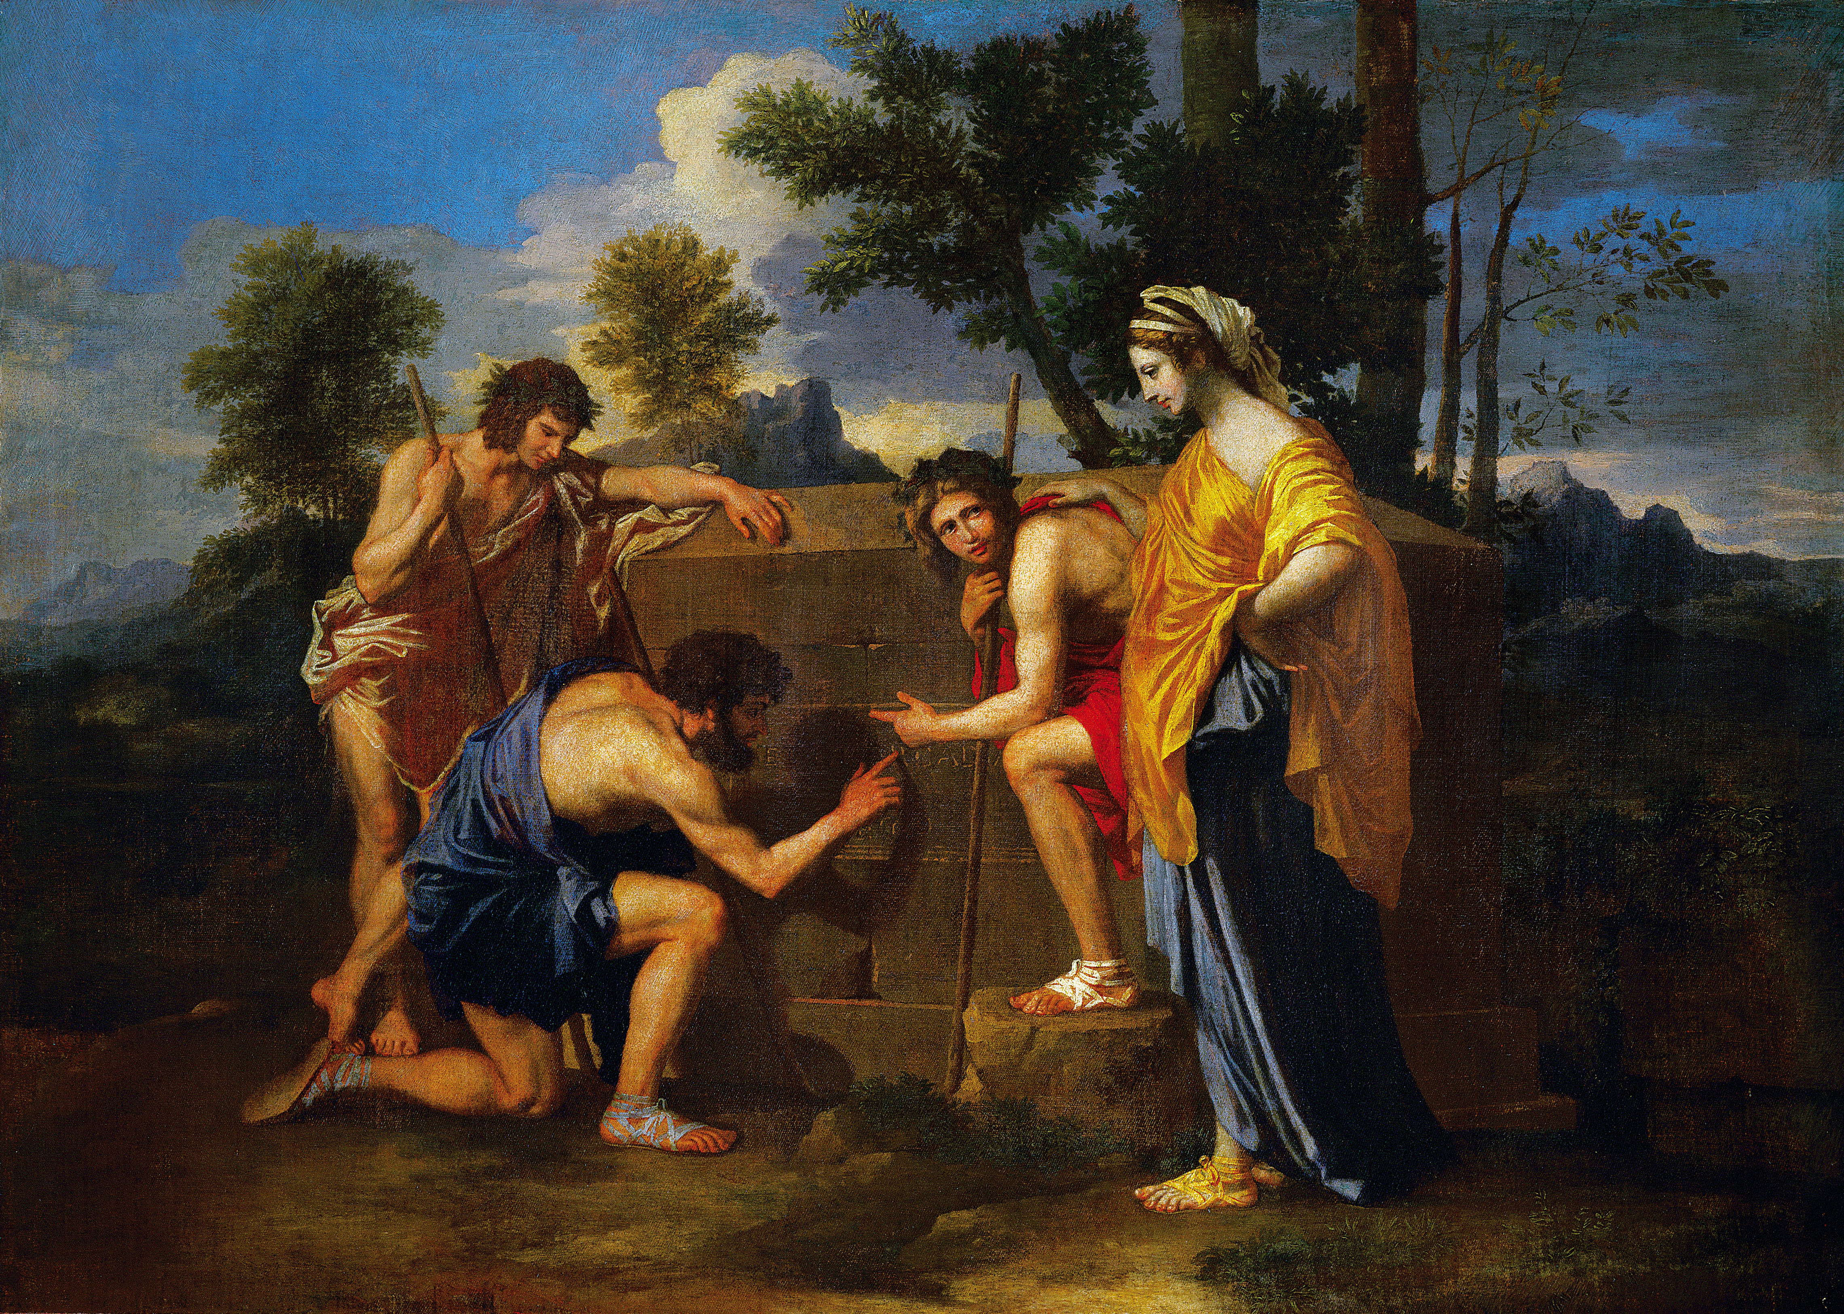
@ (25-31) Nicolas Poussin, Et in Arcadia Ego, c. 1655, Louvre, Paris
“Et in Arcadia Ego” = “Even in Arcadia, I [am or was]”

Slide 4
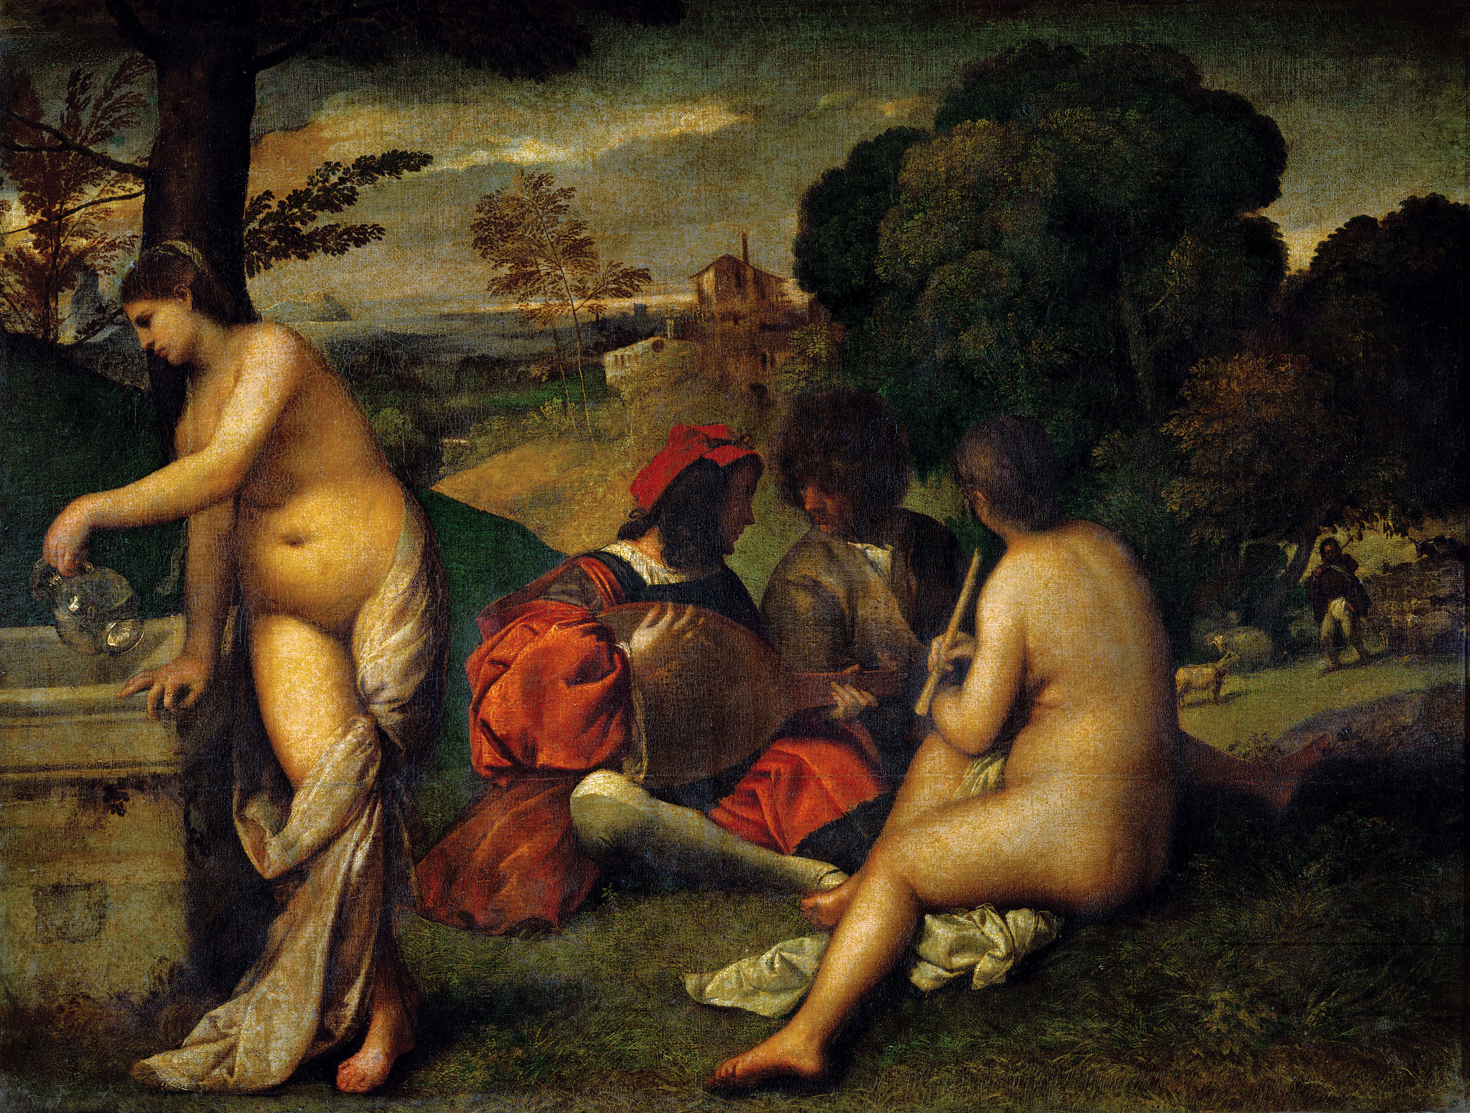
@ (25-31) Nicolas Poussin, Et in Arcadia Ego, c. 1655, Louvre, Paris
(22-23) Titian, Pastoral Symphony, c. 1508-11, oil on canvas, Louvre, Paris
“Et in Arcadia Ego” = “Even in Arcadia, I [am or was]”

Slide 6
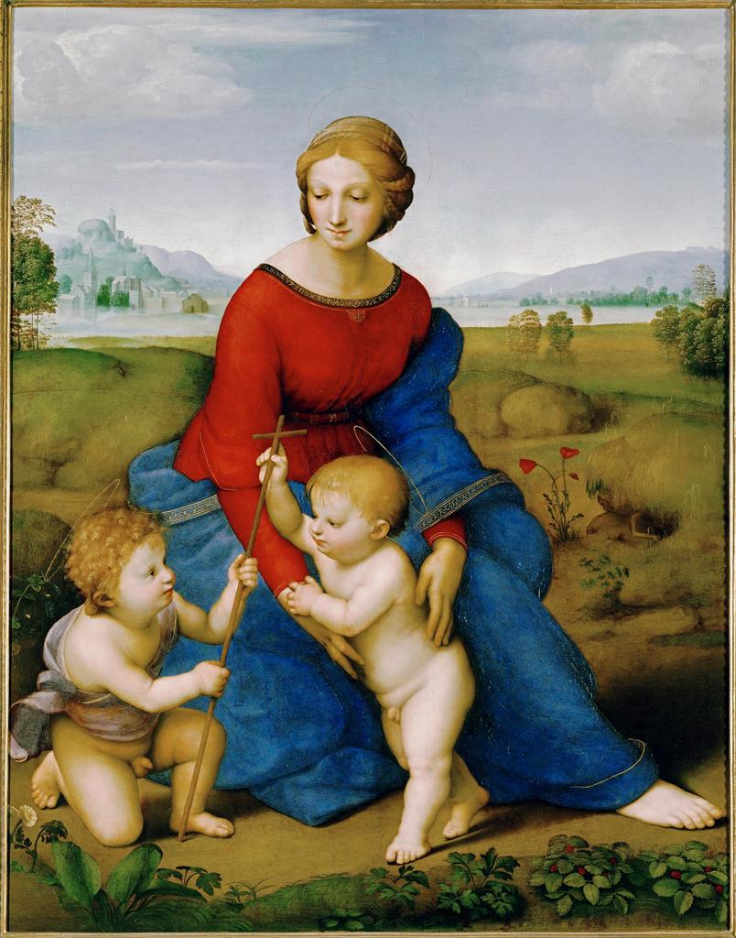
(22-8) Raphael, Madonna of the Meadow, c. 1505-6, oil on wood, Vienna

Slide 7
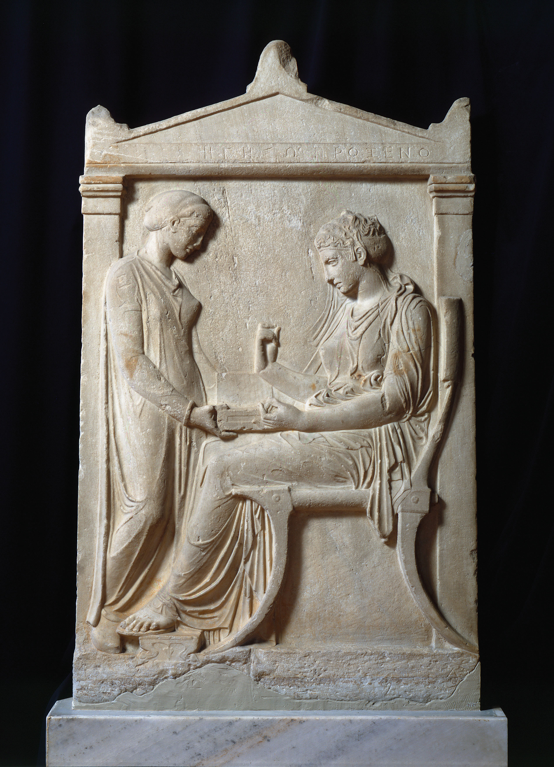
Grave stele of Hegeso, Greece, c. 400 BC

Slide 8
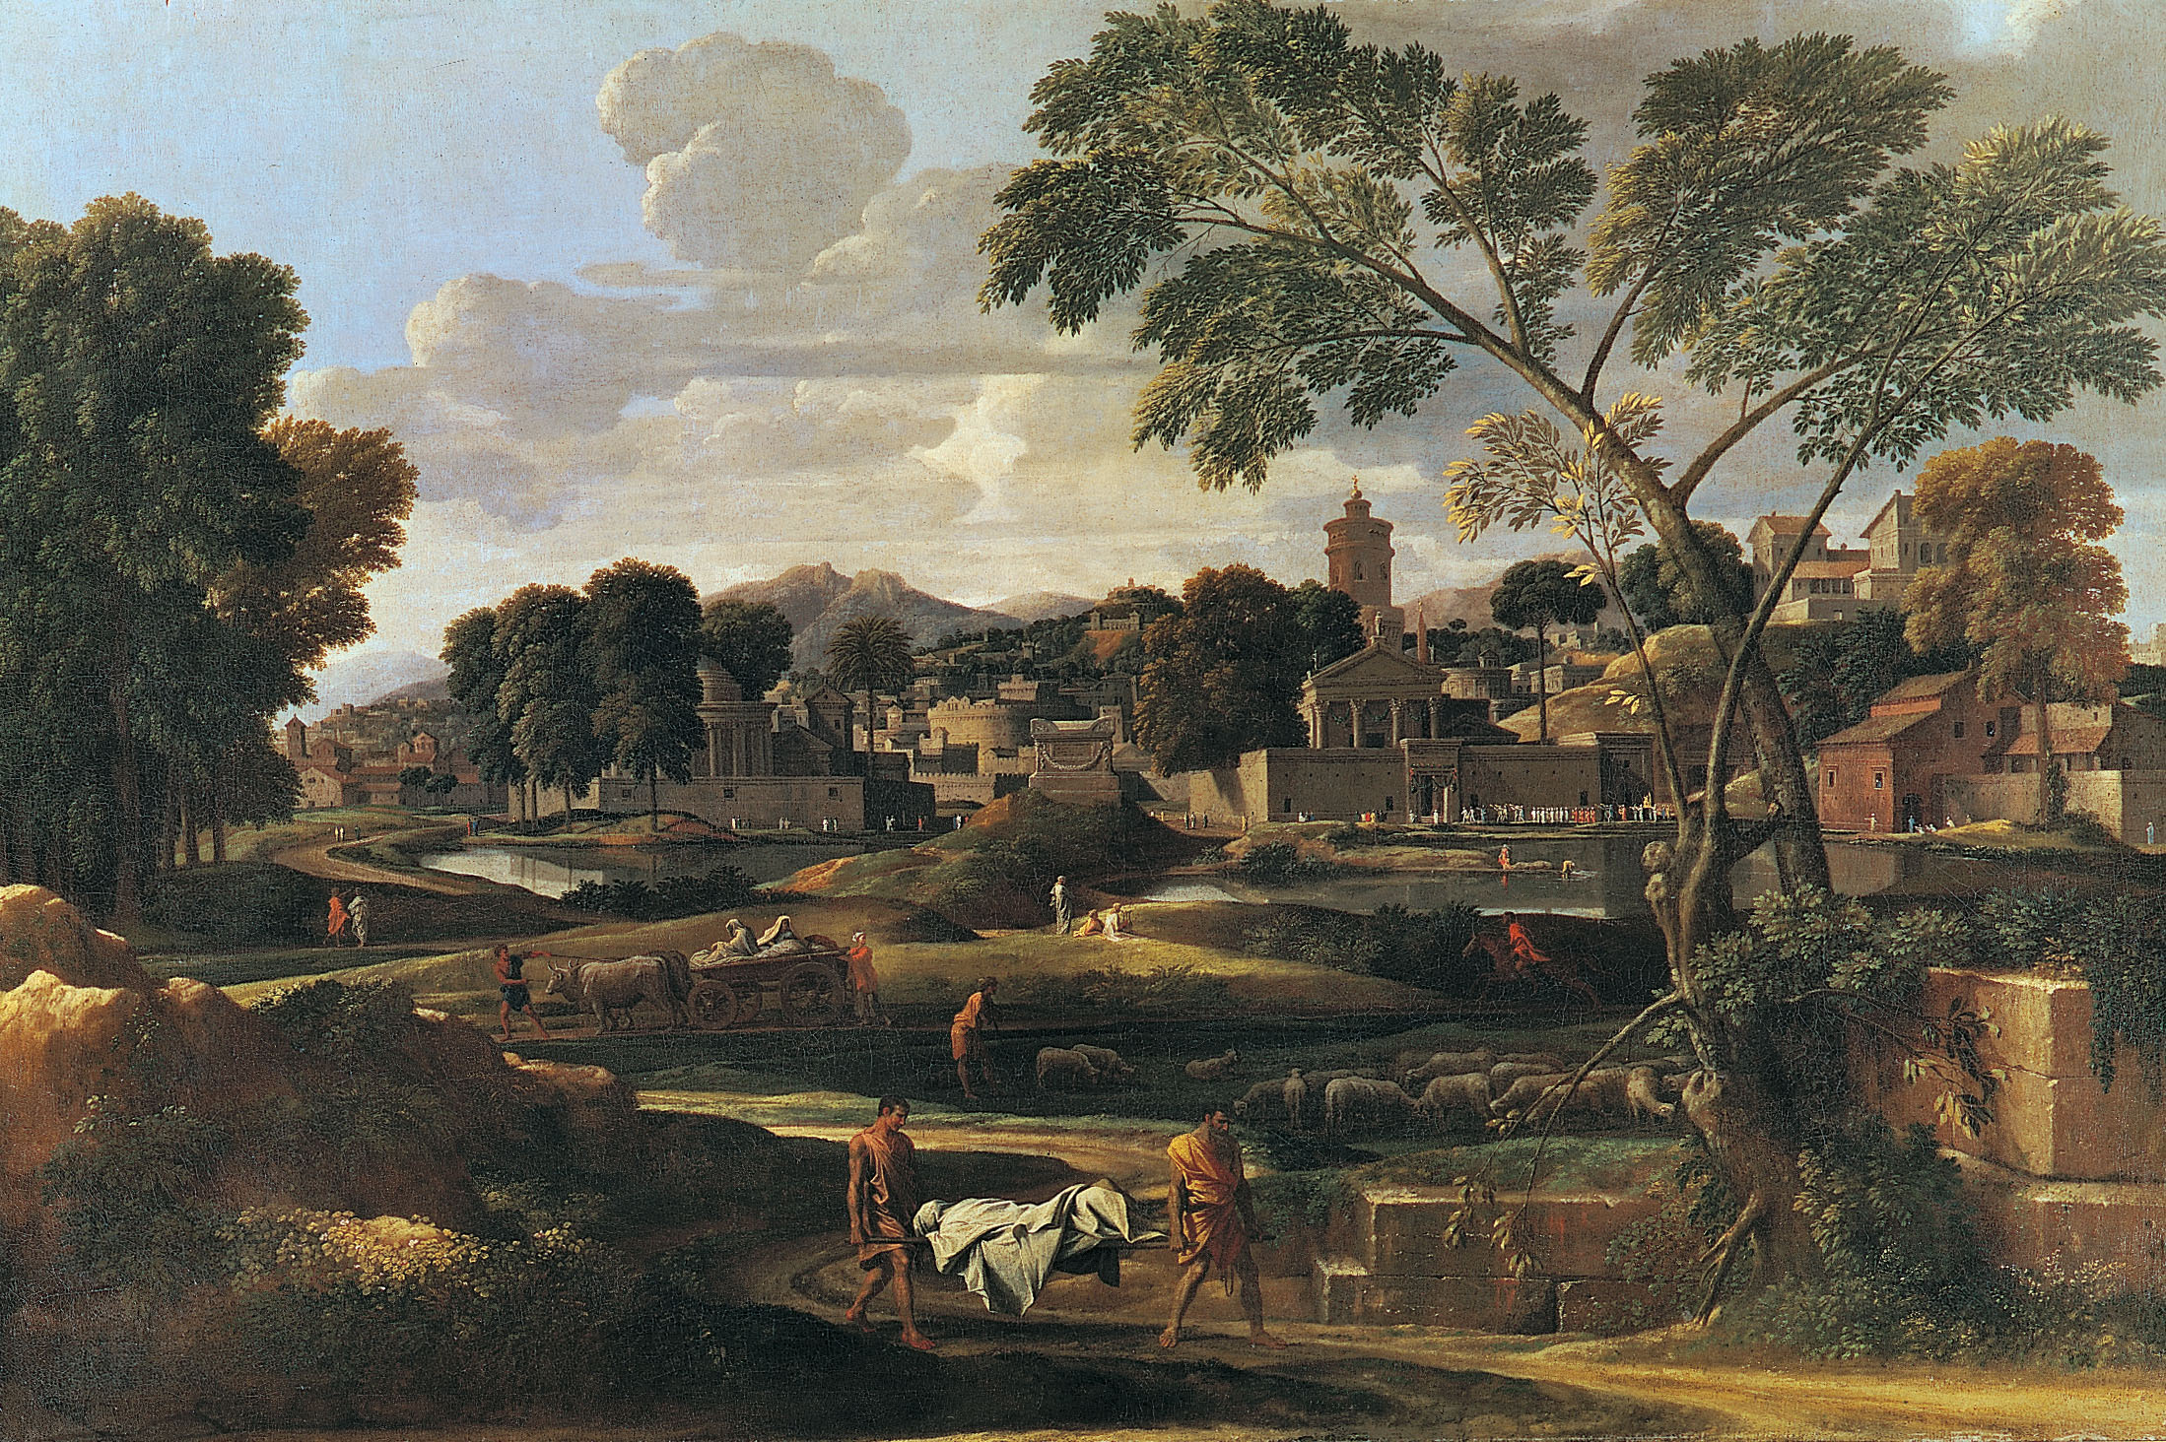
Nicolas Poussin, Burial of Phocion, 1648
From Poussin’s Notes for a Treatise on Painting: “The grand manner… The first thing …is that the subject-matter shall be grand, as are battles, heroic actions, and divine things. …The painter’s next consideration is to keep away from minutiae…[and paint only] things magnificent and grand…Those who elect mean subjects take refuge in them because of the weakness of their talents…The idea of beauty does not descend into matter unless this is prepared as carefully as possible. This preparation consists of three things: arrangement, measure, and aspect or form… [with reference to] Polykleitos’s Prescription for the Perfect Statue…”
Christian Neo-Stoicism

Slide 9
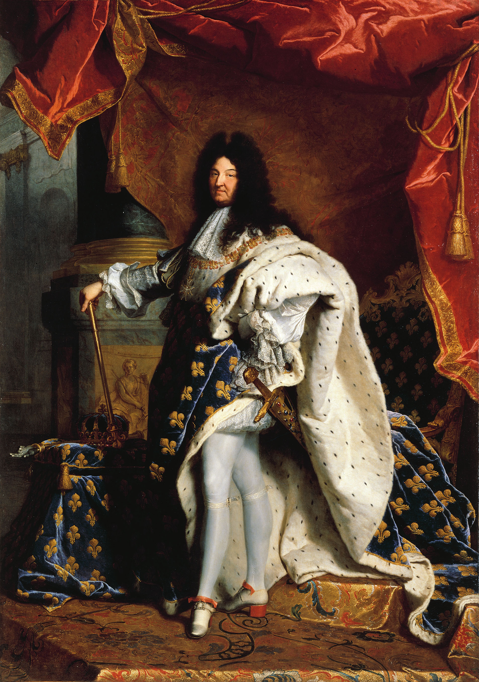
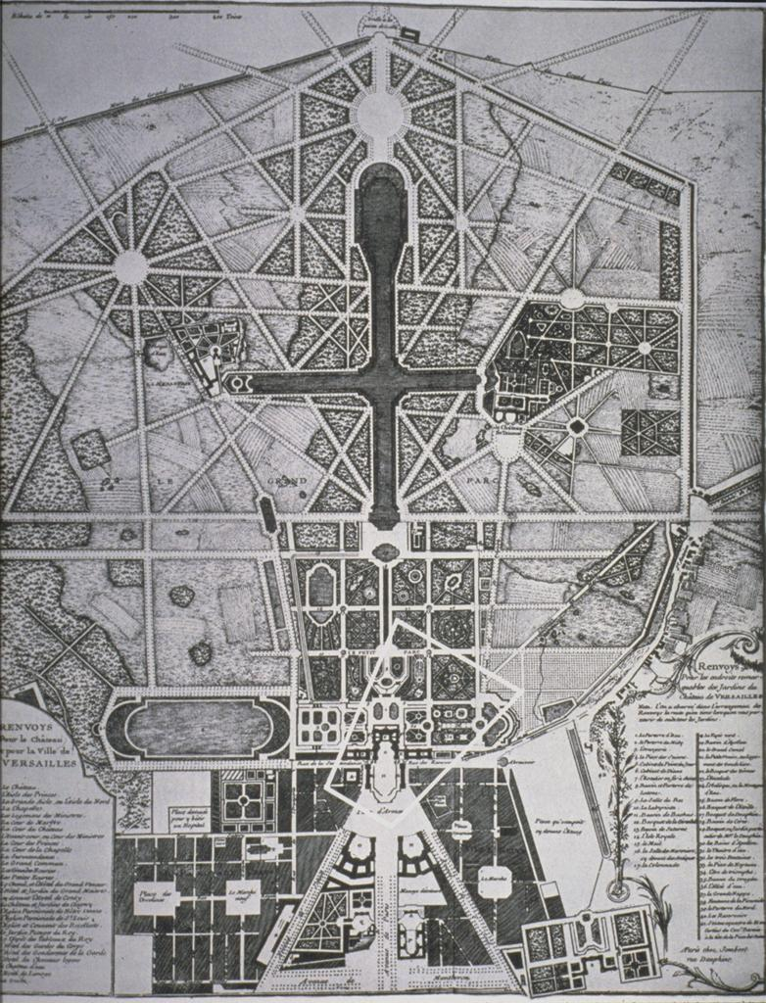
(25-24) Hyachinthe Rigaud, Louis XIV, 1701
Louis XIV (reigned 1661-1715), le Roi Soleil (the “Sun King”)
Plan of Versailles and gardens designed by Andre Le Notre

Slide 10
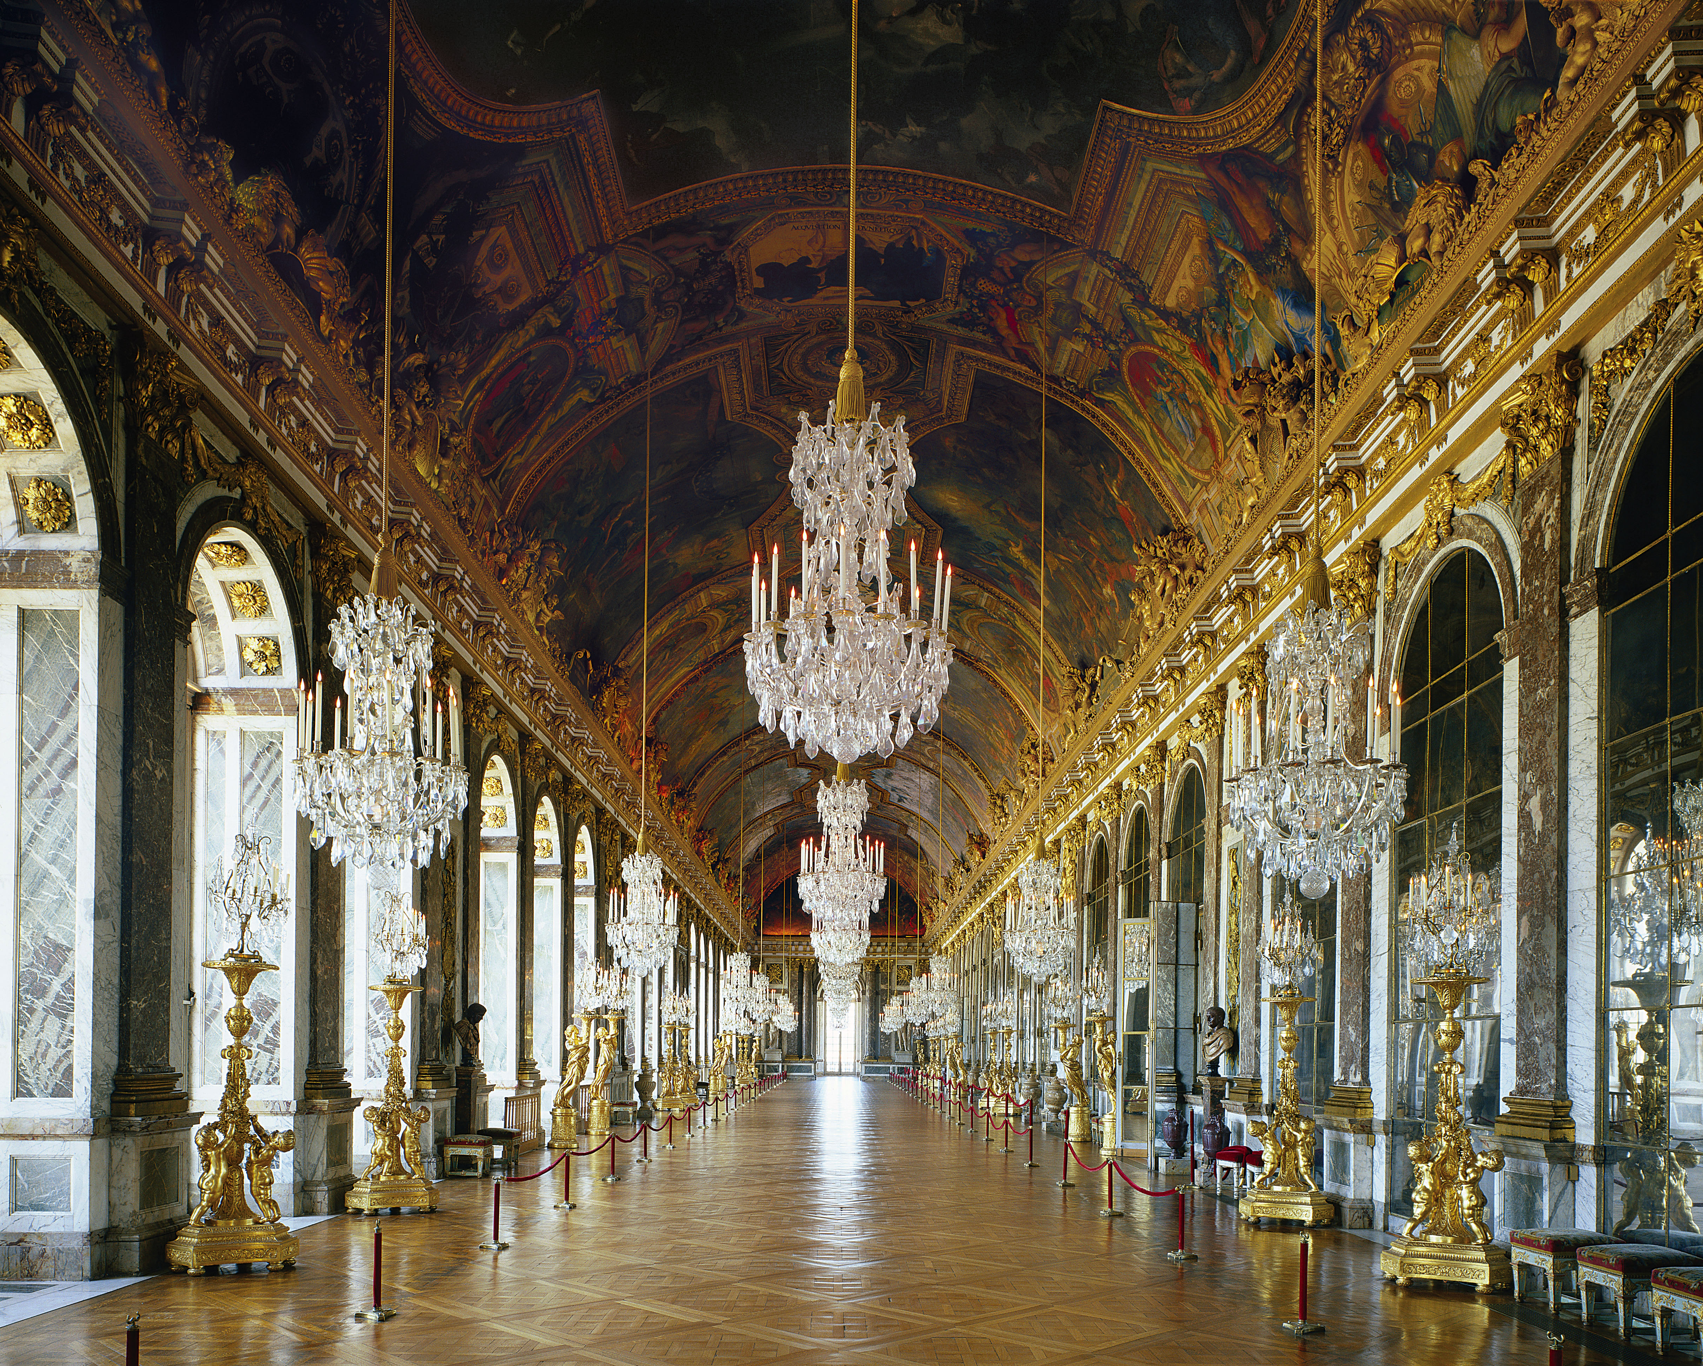
(25-27) Jules Hardouin-Mansart and Charles Le Brun, Galerie des Glaces, Versailles, c. 1680

Slide 11
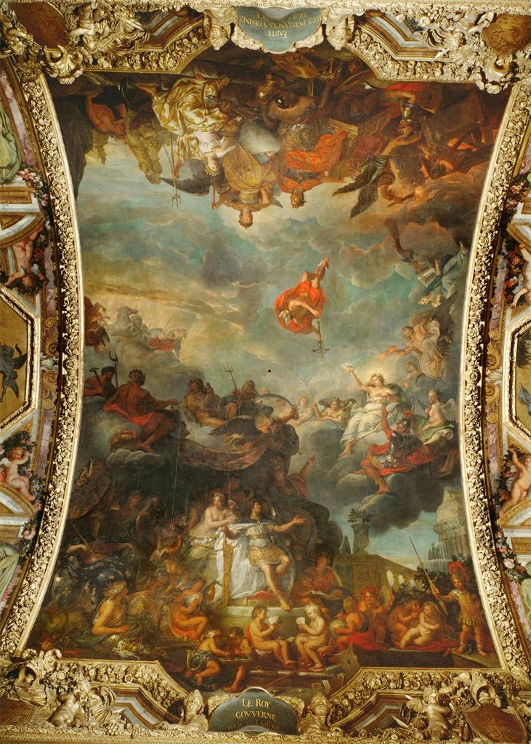
Charles Le Brun, Glorification of the Rule of Louis XIV, c. 1680, Galerie des Glaces, Versailles

Slide 12
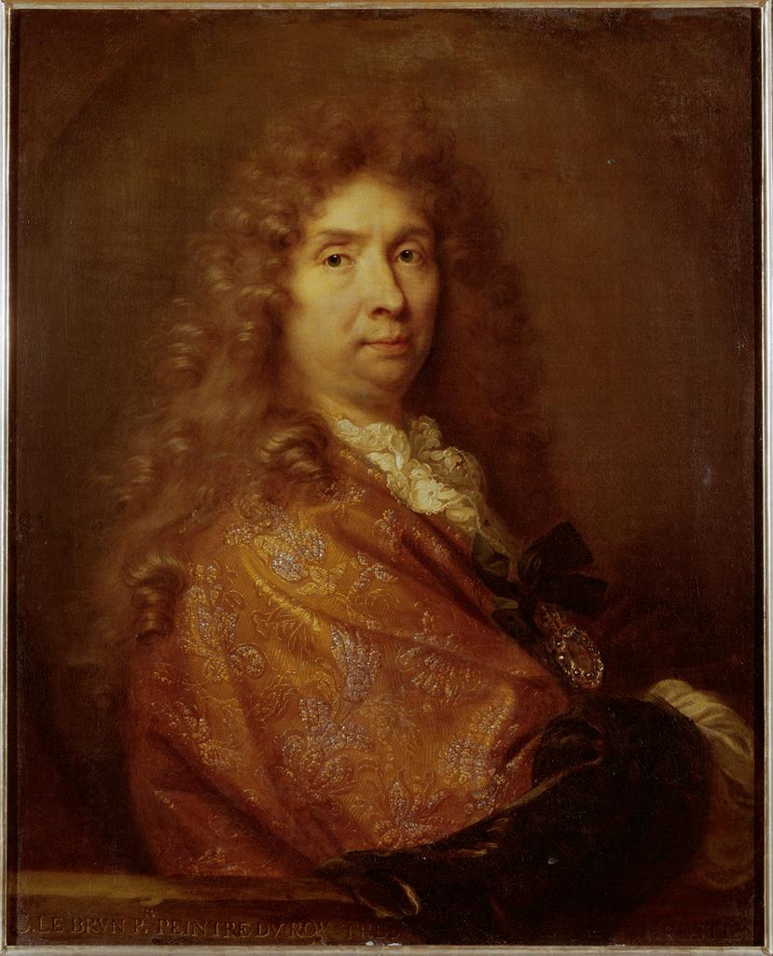
Charles Le Brun, Glorification of the Rule of Louis XIV, c. 1680, Galerie des Glaces, Versailles
Charles Le Brun, Self Portrait, 1683-4, Uffizi, Florence
Louis XIV (reigned 1661-1715), le Roi Soleil (the “Sun King”)
Charles Le Brun, Director of the Royal Academy of Painting and Sculpture, 1663-1690
Andrei Felibien and the “hierarchy of the genres”

